Slide 1
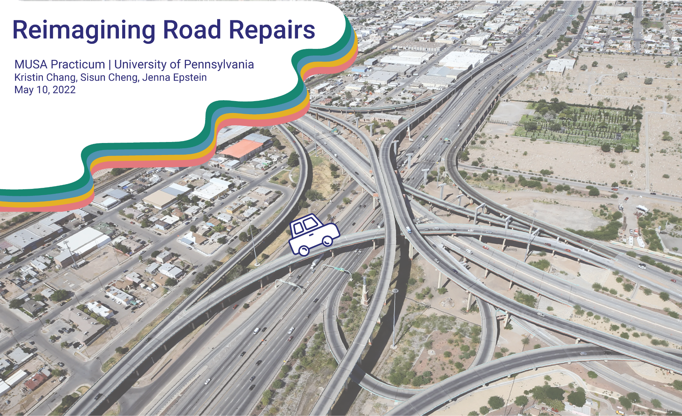
Notes:
Hello everyone! I’m Jenna....For our project, we reimagined road repairs by developing a predictive model and accompanying web application to help the Capital Improvements department in El Paso, TX, make more informed decisions when allocating where and how to distribute capital improvement funds for road repair projects
But first, we’d like to give a special thanks to Alex Hoffman at El Paso’s Capital Improvements department for working with us on our project and being so enthusiastic about propelling this work forward. We’d also like to thank MUSA faculty members Michael, Matt, and Mjumbe for their support in advising our project.

Slide 2
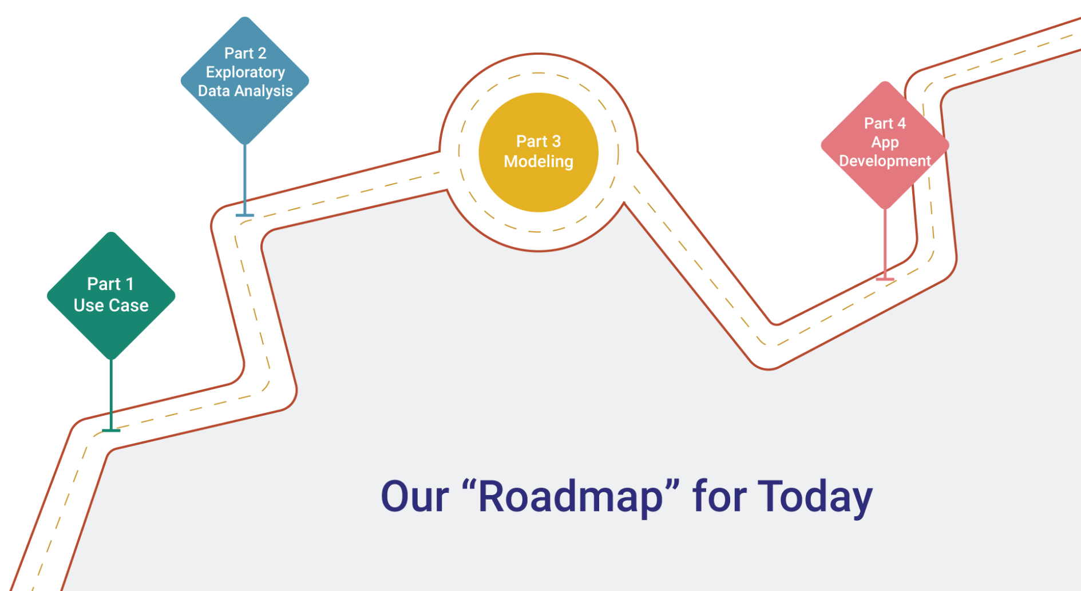
Notes:
Our road map for today, we’ll start with context & use case

Slide 3
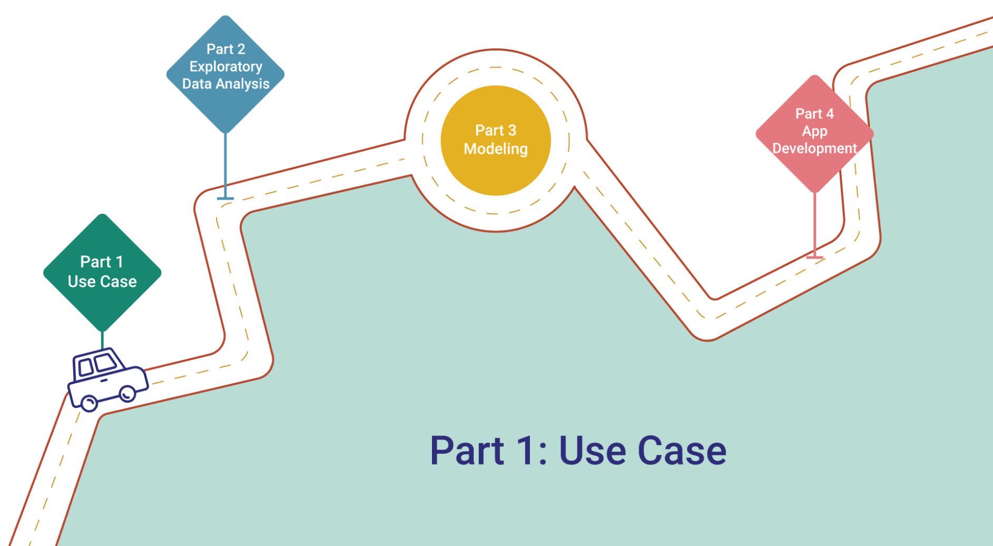

Slide 4

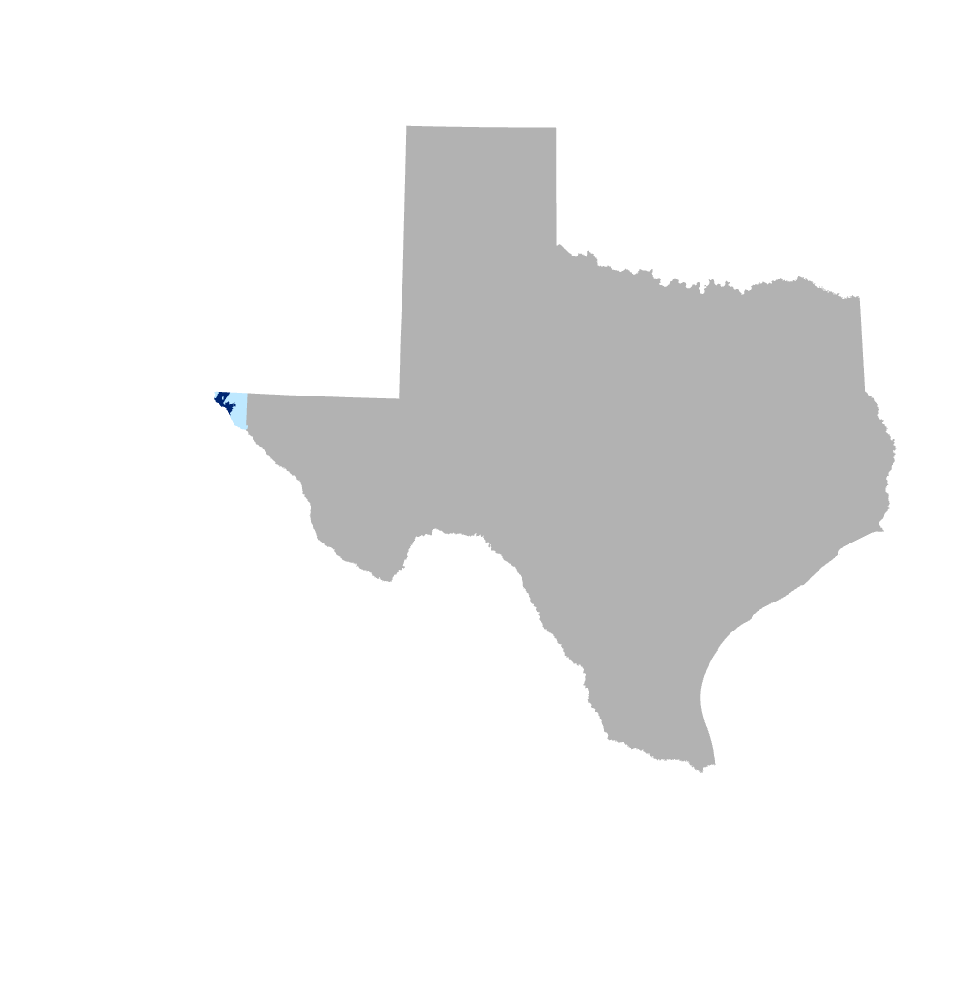
Fort Bliss
El Paso City
New Mexico
Texas
El Paso County
Mexico
Project Context
Notes:
Before we get into the details, we’d like to give some quick context to frame our use case. El Paso TX is a city within the greater county of El Paso. Fort bliss, one of the largest military bases in the world, sits to the right. It is located on the westernmost tip of the state, bordering the state of new mexico to the west and the Mexican border to the south.

Slide 5

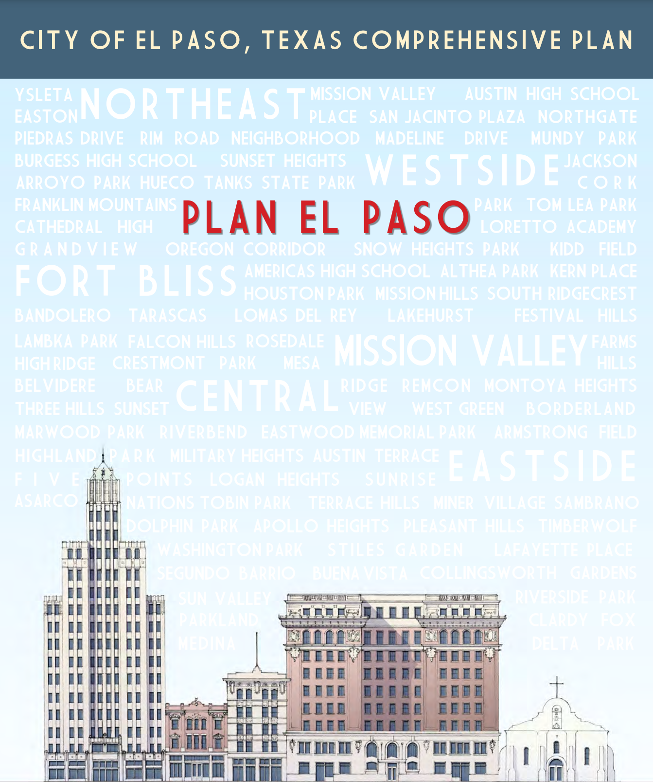
DOWNTOWN DEVELOPMENT
Project Context
Image Sources: Visit El Paso; City of El Paso, TX
Notes:
2012 Comprehensive Plan focused on downtown revitalization
El Paso has been experiencing growth and revitalization over the past decade after the city’s 2012 comprehensive plan, which revamped zoning laws and spurred investment across the city. Downtown especially has blossomed with public and private development projects - including a new triple-A baseball stadium, improvements to international bridges, adaptive reuse of historic buildings, and designation of a downtown arts district.
With more visitors and commuters comes increased pressures on road infrastructure.

Slide 6
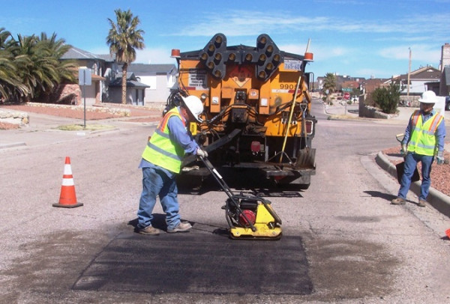

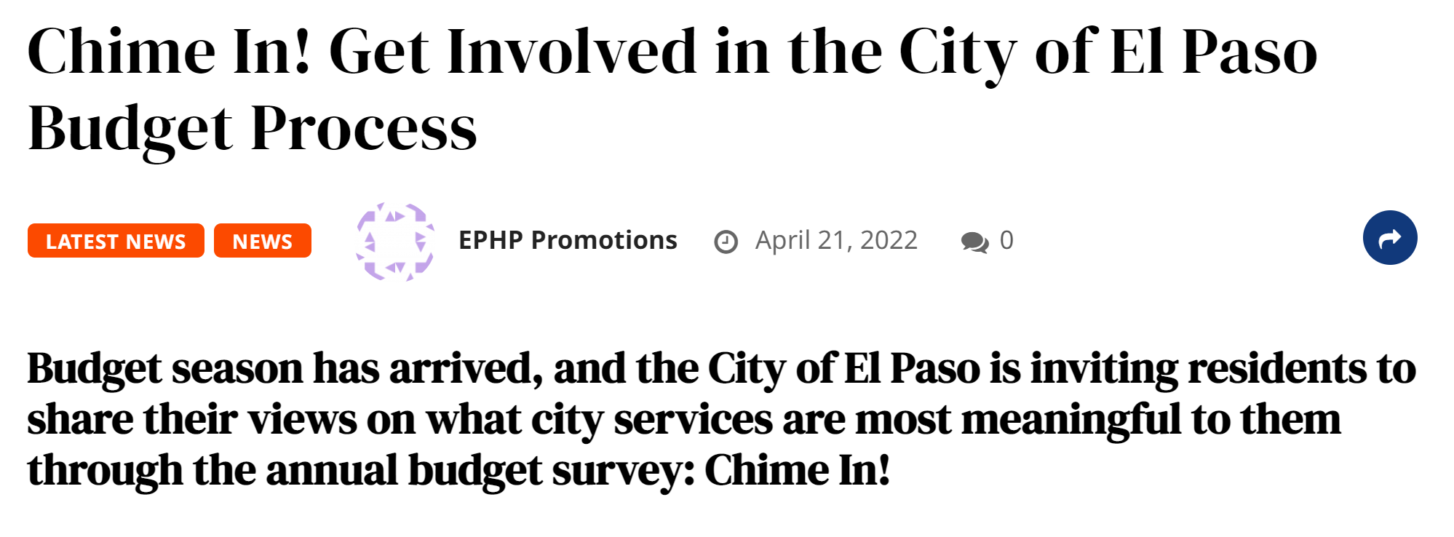
Use Case
Image Sources: City of El Paso, El Paso Herald Post
Notes:
So the City of El Paso’s Capital Improvement Department (Planning Division) wants to improve their system for deciding where and how to allocate capital improvement funds for road repair projects. Presently, this is influenced primarily by a PCI - a Pavement Conditions Index score - assigned to each road segment across the city.
The client informed us that there is a upcoming budget meeting. They are receiving a bond package and will be meeting to decide how much to allocate to infrastructure improvements. This is a concrete opportunity for them to use our project to advocate for allocating more of that money to pavement repair - and how choices can impact the community proactively.

Slide 7
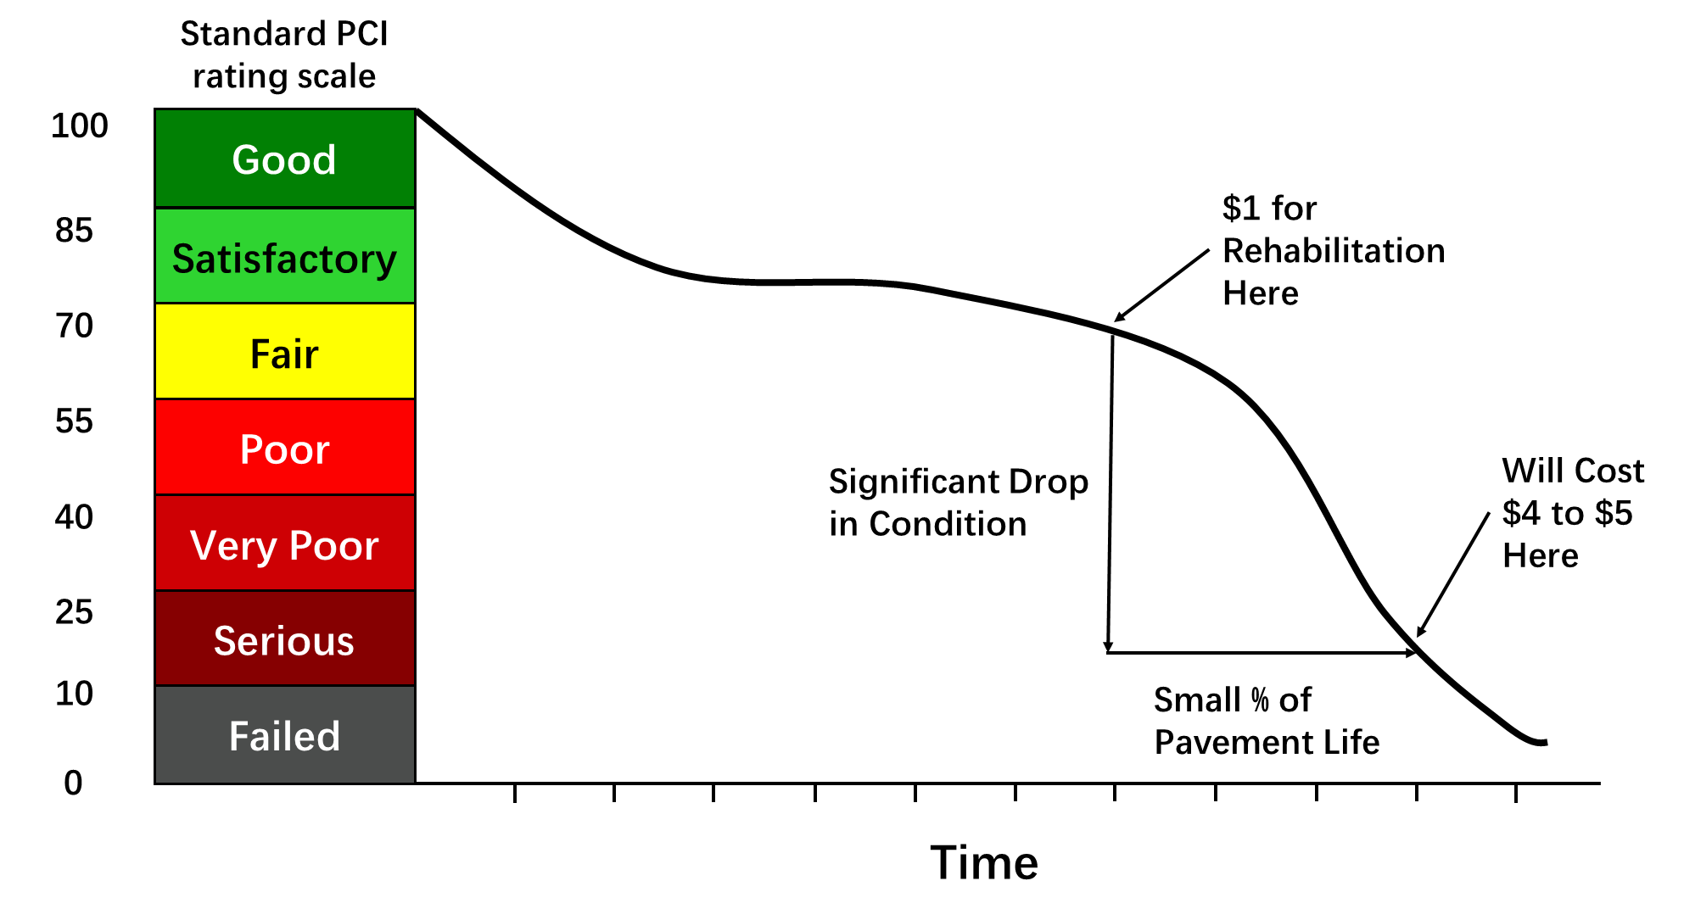
What is PCI?
Use Case
Graphic Informed by Colorado State University - PAVER software
Notes:
PCIs are based off of factors such as presence of potholes, bumps, or cracks. The index ranges from a qualitative scale of Failing to Good or quantitatively 0 to 100.
Typically there is a significant drop in condition of a road after a certain amount of time.
In El Paso, PCI scores inform the decision making, but lots of the decisions are ad hoc. For example, constituents raise concerns about certain roads, the department looks at the PCI score, and if it is below a certain threshold, then they add it to the list of projects for improvement.
This is a very reactive process - and as mentioned, they would like it to be more proactive.

Slide 8
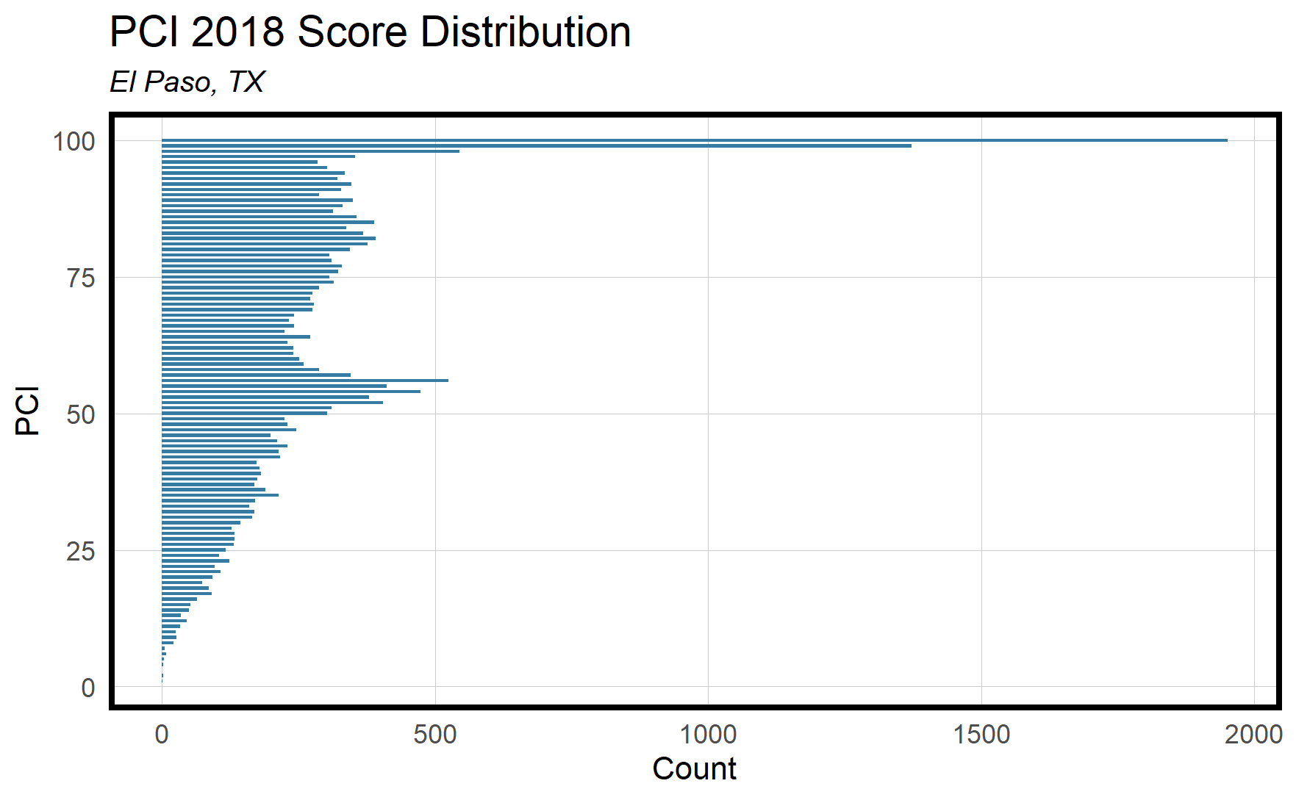

Good
Poor
Failed
Use Case
Notes:
PCI was most recently generated by a proprietary digital image scan by a contractor in 2018.
This chart depicts the count of road segments by their PCI score and reveals that the roads in El Paso are generally in Fair to Good condition. There is a spike in the graph around the 40 to 55 range which equates to Very Poor or Poor ratings.
But PCI also doesn’t tell the whole story, and the city wants to explore other factors that may drive a new prioritization system....

Slide 9
Project Objectives
Objective 1
PCI Predictive Model
Use Case
Objective 2
El Paso Road Viewer
(Web App)
Use Case
Notes:
This leads to our project’s main objectives.
First, we have the predictive model. We use historical data to predict PCI for 2021.
The second part is the web app we’ve created, the El Paso Road Viewer - better known as EP RV
In the app, we incorporate our predicted 2021 PCI, but it is just one piece of the resource allocation and prioritization puzzle.

Slide 10
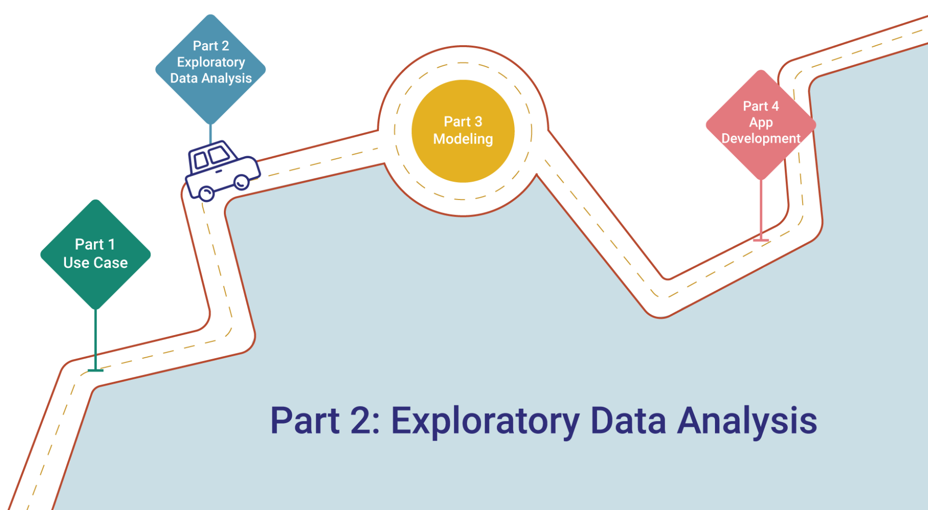
Notes:
Hand off to Kristin to talk about some of our exploratory data analysis.

Slide 11
Exploratory Data Analysis
Data Cleaning & Processing
Feature Engineering
Model
Exploratory Data Analysis
Notes:
For those unfamiliar, the overall process for building a prediction model is to clean and process the data and then do some engineering to create features that serve as the inputs for the model.

Slide 12
Features
Road Conditions | Environment | Road Network
Roadbed Base Material | Land Use | Road Class
Roadbed Surface Material | High Risk Flood Areas | Distance to Nearest Major Intersection
Road Age | Distance to Hydrology | Distance to Nearest Major Arterial
Potholes | Distance to Amenities | Crashes
Roadbed Width* | Proximity to Interstate 10 | Vehicle Miles Traveled
 | Land Cover* | Traffic Jams*
Exploratory Data Analysis
* Not included in final modeling
Notes:
To create these features, we thought about various factors that contribute to the “wear and tear” of a road.
We organized these into 3 groups:
Road Conditions - or the physical properties of a road
Environmental Conditions - any aspects of the surrounding area that may affect road conditions, like if there’s water nearby or if these are roads people use to get to shopping areas or work
Road Network - or how the different road segments interact with one another
Here are some of the features we hypothesized would strongly influence PCI score and we’ll dive a little deeper into these on the next slides

Slide 13
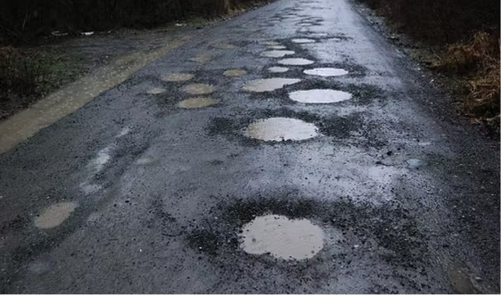
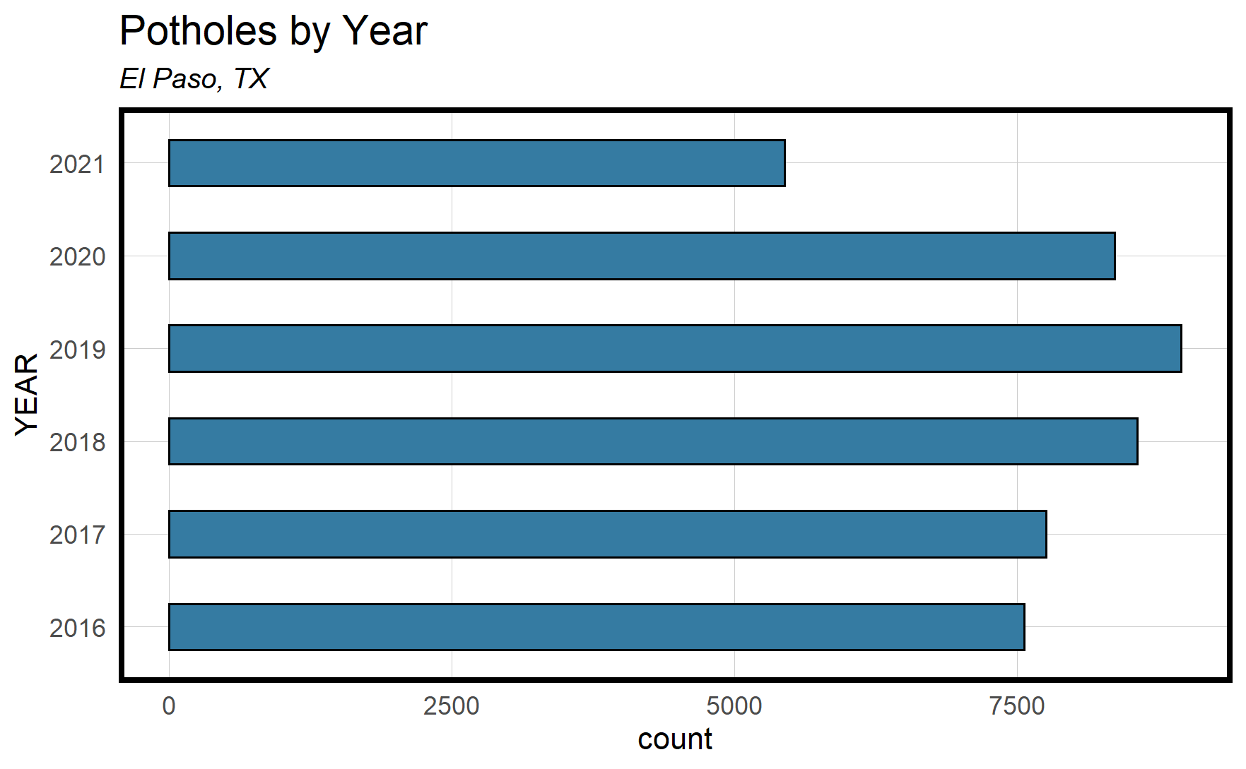
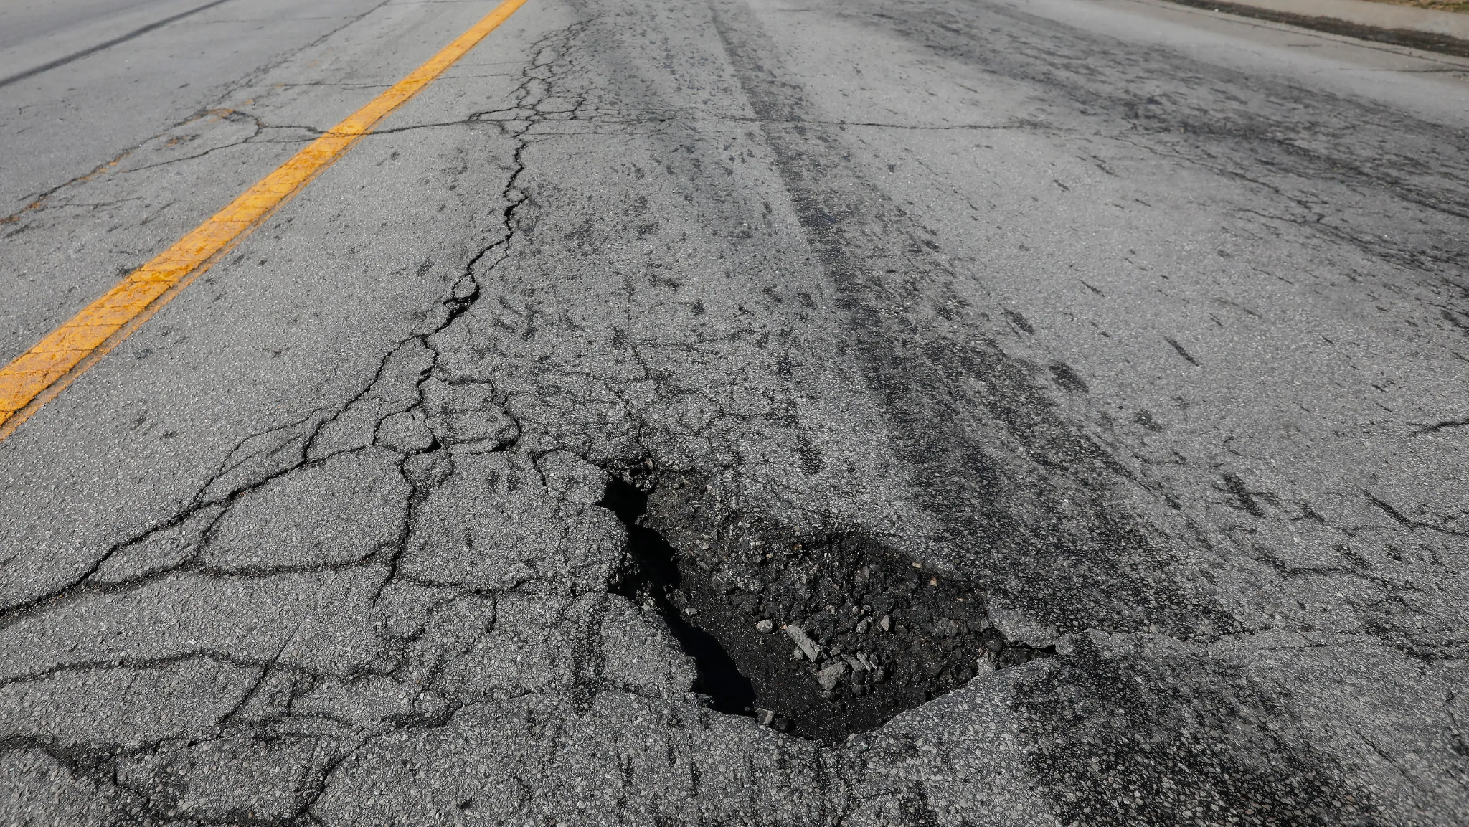
Road Conditions: Potholes
Exploratory Data Analysis
Image Sources: Forbes, Las Cruces Sun-News
Notes:
Potholes - we all know and love them, but they’re dangerous. You can see in the chart that El Paso roads have had over 5,000 potholes each year since 2016.
Our client hinted that the presence of potholes can significantly decrease PCI scores so we definitely wanted to include this data in our model.
We calculated how many potholes were present per foot of each road segment and this ended up not being our most important feature, but still had a significantly strong influence on PCI.

Slide 14
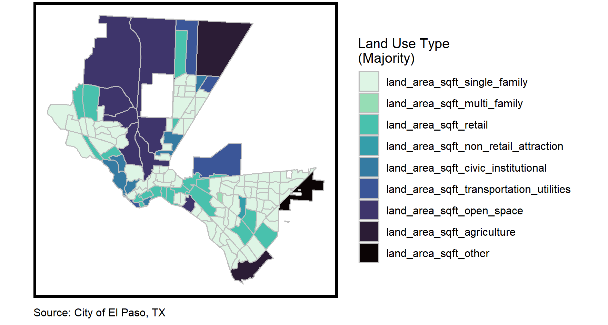
Environment: Land Use by Census Tract
Single Family
Multi Family
Retail
Non Retail Attraction
Civic Institutional
Transportation Utilities
Open Space
Agriculture
Other
Exploratory Data Analysis
Notes:
Another hypothesis we had is that land use type would heavily influence PCI score.
For the non-city planners in the room, land use zoning is a planning tool that prescribes how the land area should be used in the future.
This map shows that El Paso is mostly zoned for single family housing as well as retail downtown.
This feature also had a fairly strong influence on PCI score when put into the model.

Slide 15
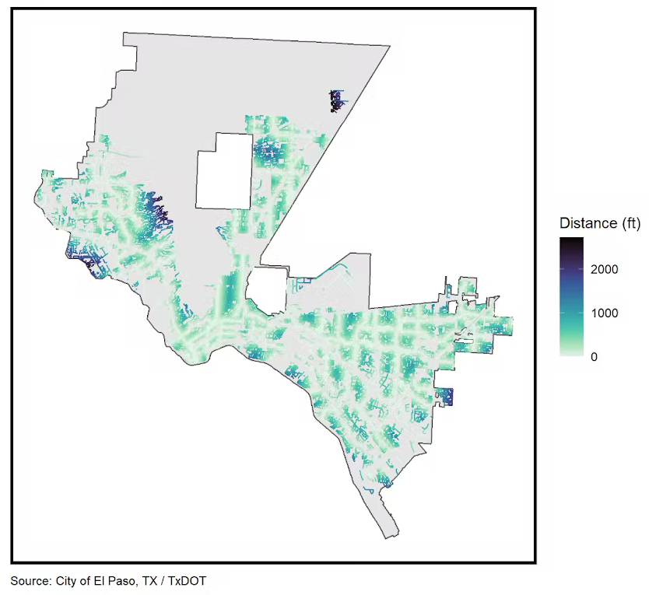
Road Network: Distance to Major Intersections
Exploratory Data Analysis
Notes:
Lastly, we figured roads close to major intersections would be used more often. So we calculated how far each road segment is from a major intersection.
This feature ended up performing really well in our model and so we also calculated the distances of each road from major arterial (like a highway or major road) and that ended up being very helpful too.

Slide 16
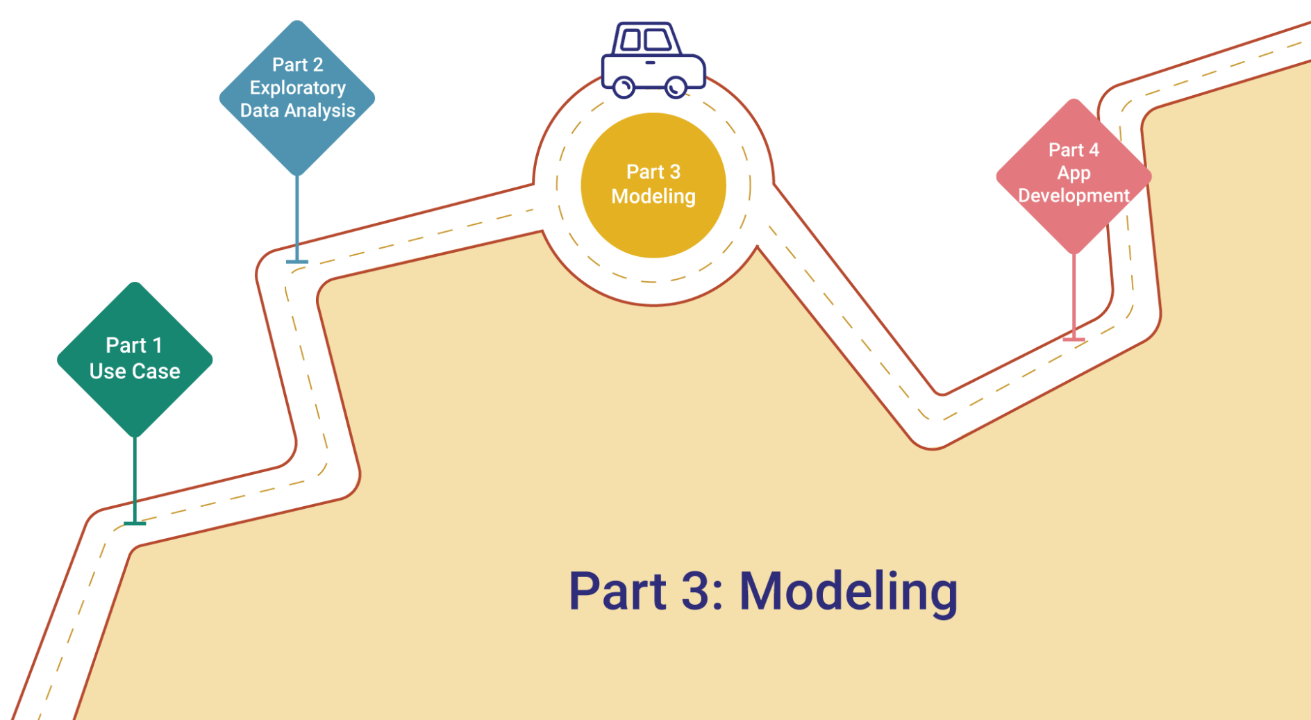
Notes:
Hand off to Sisun to talk about our modelling approach

Slide 17
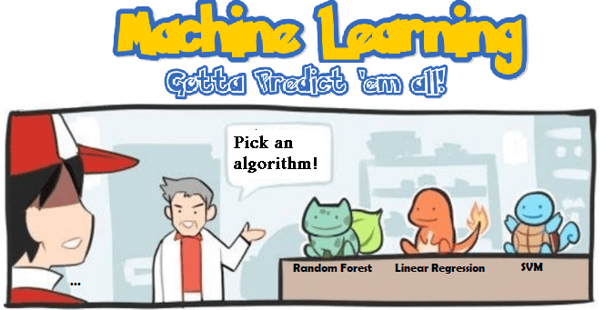
Model
Train Set
Predicted PCI
Data Cleaning & Processing
Feature Engineering
Actual PCI
Test Set
Errors
Model | Mean Absolute Percent Error (MAPE)
OLS | 39.04%
SVM | 47.11%
XGBoost | 27.18%
Random Forest | 25.31%
Modeling
Image Source: https://www.claoudml.com/blog/machine-learning-made-easy
Notes:
After feature engineering we split all of the data into a training and test set
We input the training set into several different models and used them to predict PCI scores
Then we calculated errors by subtracting the actual PCI scores using the test set
This chart shows the results of the different models we used with their Mean Absolute Percent Error
Random forest is the best!

Slide 18
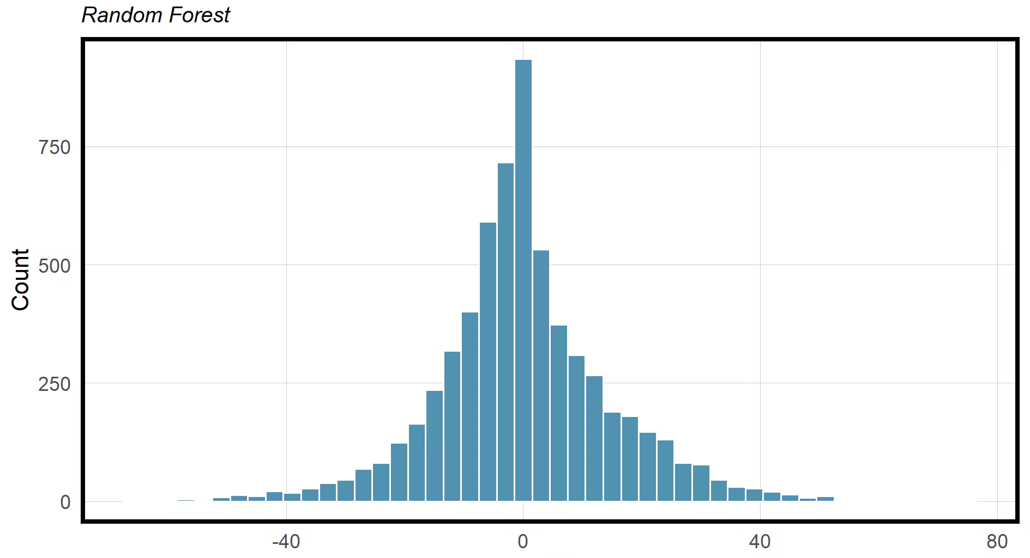
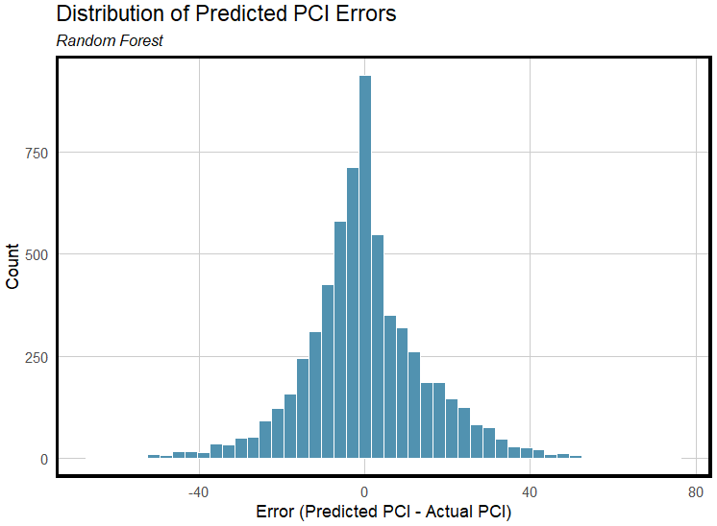
Error Distribution
Error (Predicted PCI - Actual PCI)
Modeling
Notes:
Here is a closer look at the raw errors from the random forest model
Most errors are clustered around 0 which means there was little to no difference in predicted PCI scores
These are great results!

Slide 19
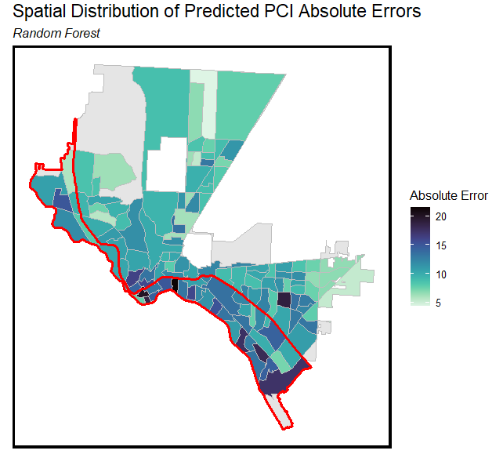
Spatial Distribution of Errors
Interstate 10
boundary area
Modeling
Notes:
To visualize the same errors over space, we summarized the predictions by census tract. We can see a clear pattern that census tracts with high absolute errors are mostly located in the area below Interstate-10, a highway that cuts through the city. This shows that there is a sense of spatial inequity in our model accuracy and that we need to be cautious.
In fact, our client informed us that there has been historic disinvestment in neighborhoods south of this highway. This can lead to poor data collection or biased data collection which may be the cause of these higher errors here.

Slide 20
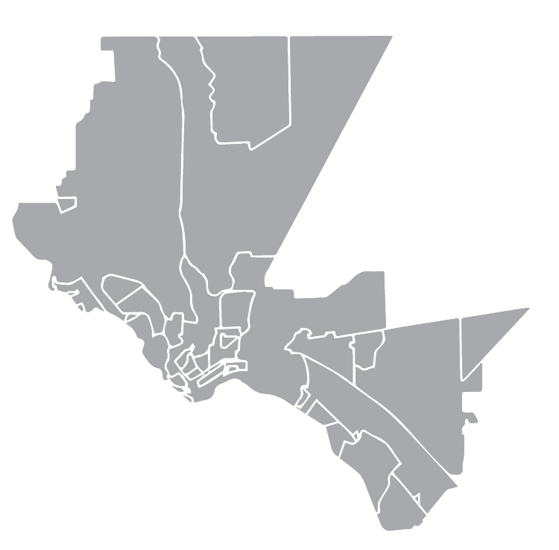
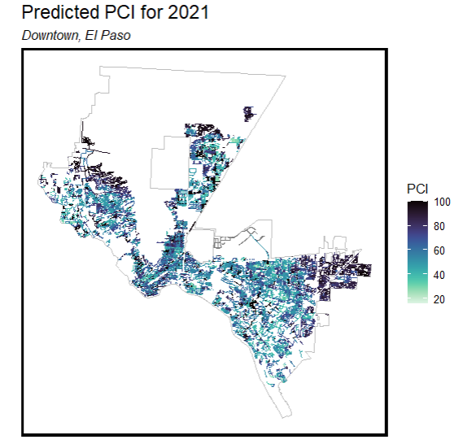
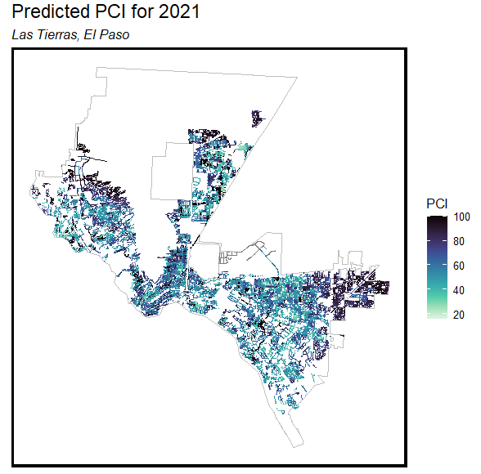
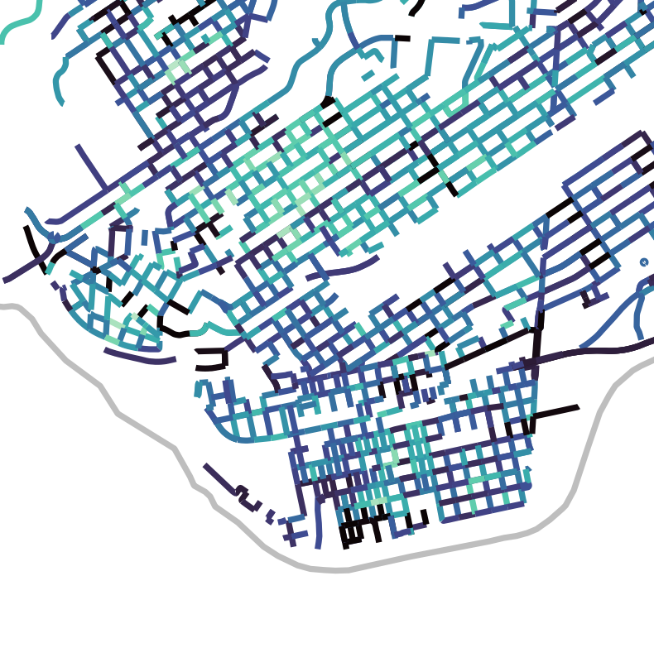
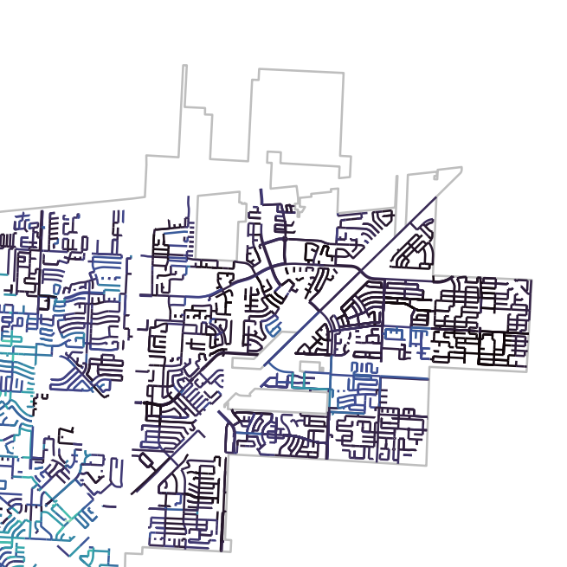
2021 PCI Predictions
Modeling
Notes:
After evaluating the model on the training and test set, we can apply it to 2021 data to predict PCI scores
Here we show those predictions for two regions of the city, downtown and the neighborhood ‘Las Tierras’ in the north-east corner of the city to show the results of our model.
Some roads in downtown El Paso have low PCI scores and have bad conditions while most of the roads in Las Tierras neighborhood have high PCI scores and are in good condition.

Slide 21
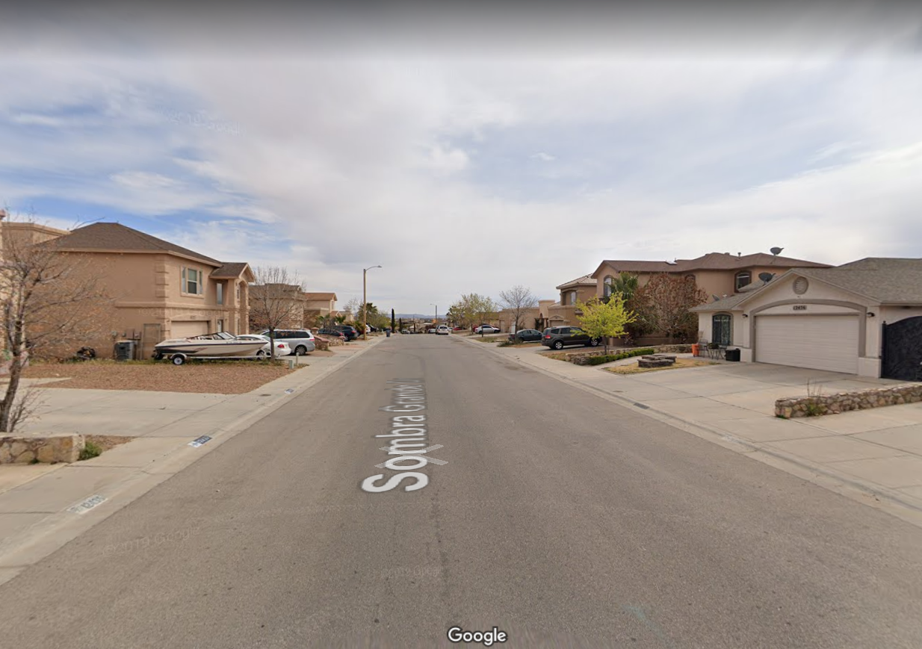
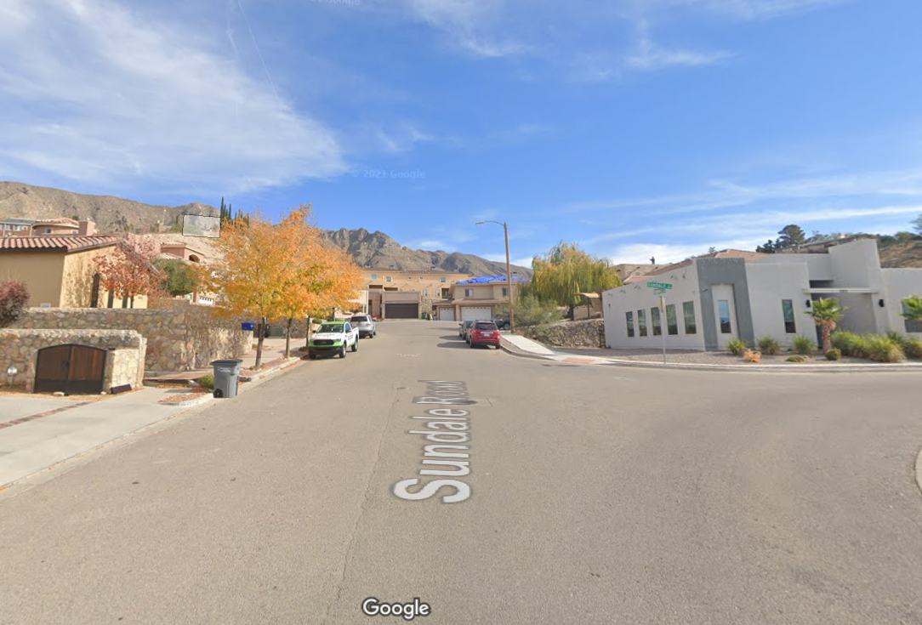
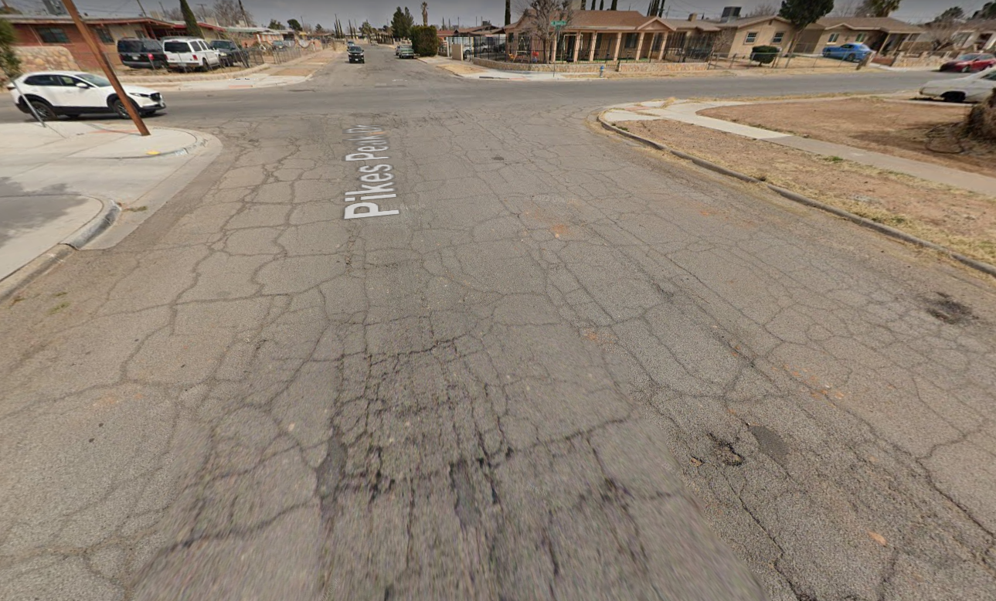
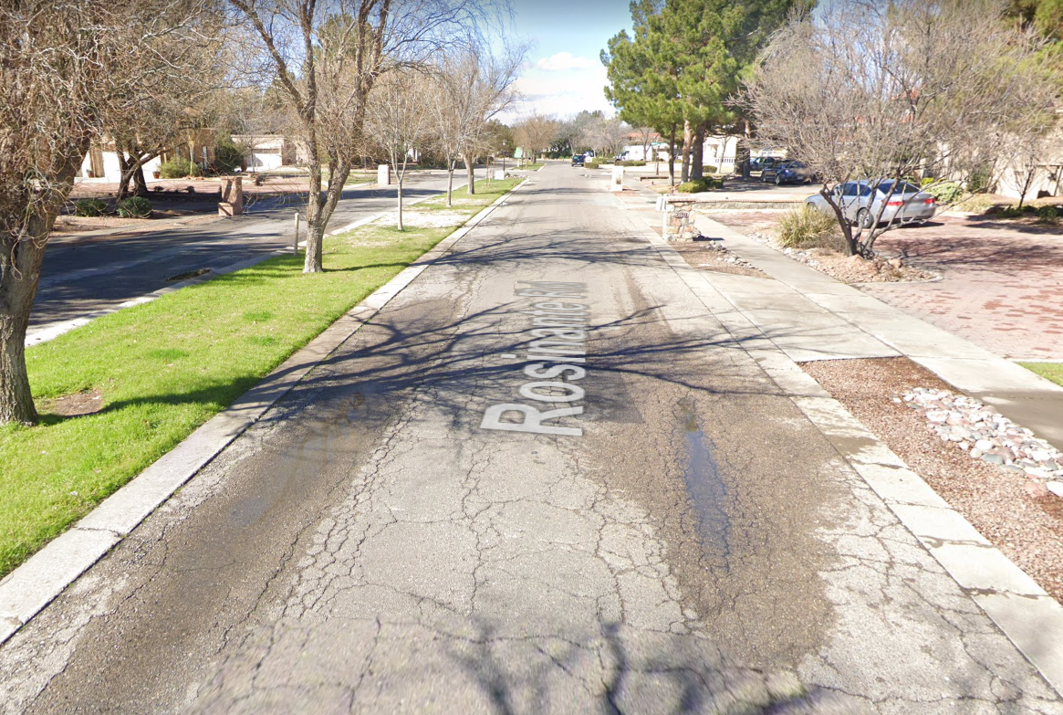
2021 PCI
Predictions
Good
Sombra Grande Drive, Predicted PCI 93
Sundale Drive, Predicted PCI 87
… how’d we do?
Poor
Pikes Peak Drive, Predicted PCI 35
Rosinante Road, Predicted PCI 26
Modeling
Image Sources: Google Maps, Accessed April 26, 2022
Notes:
Since we don’t have actual 2021 scores to calculate errors with, we selected a few road segments from the city and looked at the actual pavement conditions using google maps street view
Road segments on Sombra Grande Drive and Sundale Drive are smooth and flat and in seemingly good condition as we predicted.
In contrast, we can easily spot the potholes and cracks on the road surface of Pikes Peak Drive and Rosinante Road which indicates the road segments need to be repaired.
These conditions align with our predictions, which shows the power of our model to create a more proactive decision-making process and help the city conduct scenario planning based on forecasted futures.

Slide 22
Over-predictions
(scores are better than actual conditions)
Costs:
Some roads don’t get fixed
Benefits:
Shorter list of projects
Under-predictions
(scores are worse than actual conditions)
Costs:
Longer list of projects
Benefits:
Roads get fixed proactively!
Modeling
Notes:
However, our model is not perfect, so it is important we consider the tradeoffs of over and under predicting PCI scores and what this means for the El Paso Capital Improvements Department.
When a score is over predicted, that means the model predicts the road conditions better than they actually are
This means that some roads need to be repaired will not make the list of projects in the Capital Improvements Department
But the department will have a shorter list of projects which saves them time and resources
When a score is under predicted, that means the model predicts the road conditions worse than they actually are
This may create a longer list of projects for the department
But more roads can get attended to earlier, which can save the department money in the long run
Because of this, we think under predicting scores is better.

Slide 23
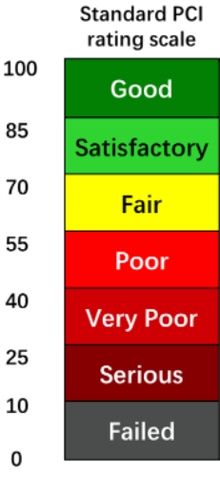
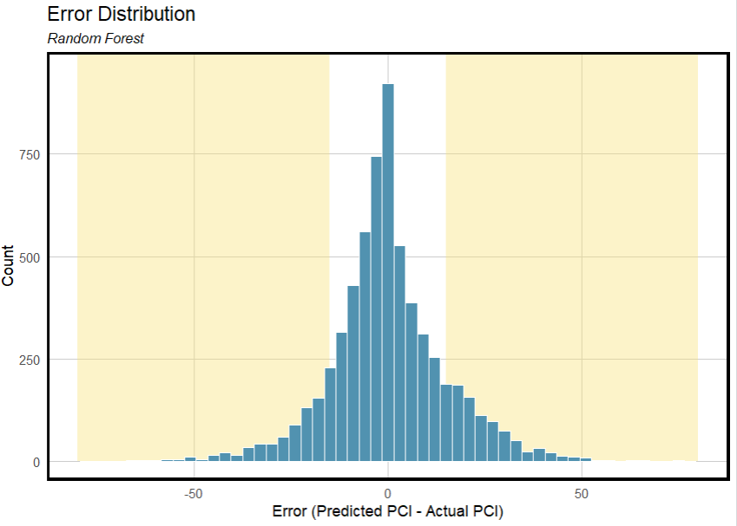
where Predicted PCI = Actual PCI +/-15 or more
Modeling
Notes:
However, keep in mind, large errors (of 15 or more) are the only ones that would really change the road’s rating - as shown by the rating scale on the left.
Based on the histogram of errors shown earlier, we have very few of these, so roads are not being misclassified that dramatically.

Slide 24
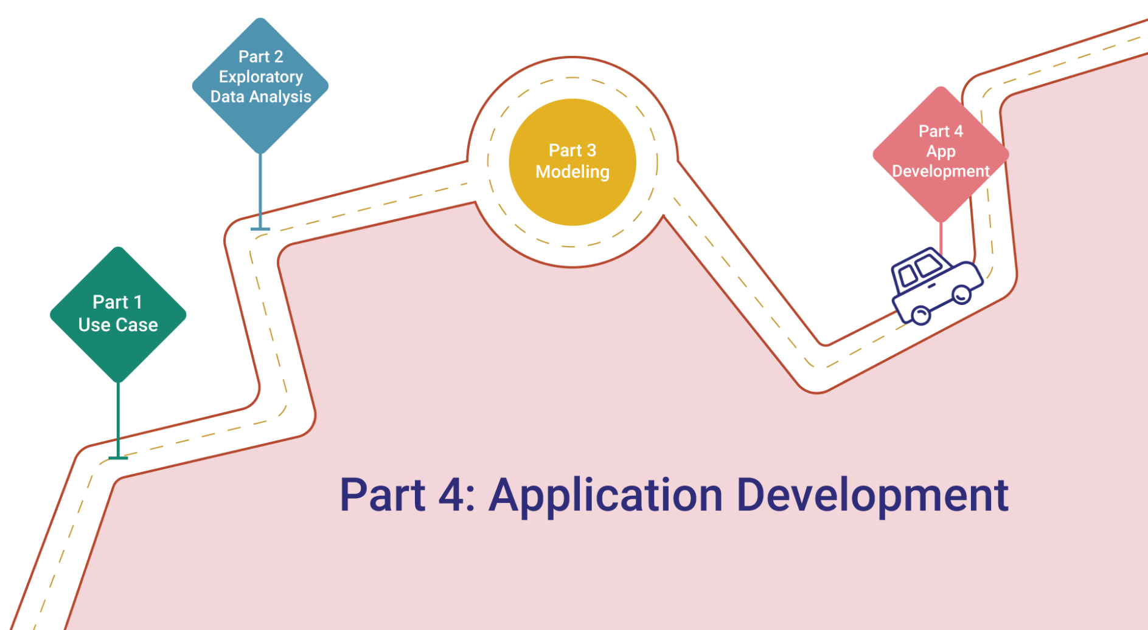
Notes:
Hand it back to Kristin to talk about how these predicted scores are used in the web app
Now we’re moving on to objective 2 of our project

Slide 25
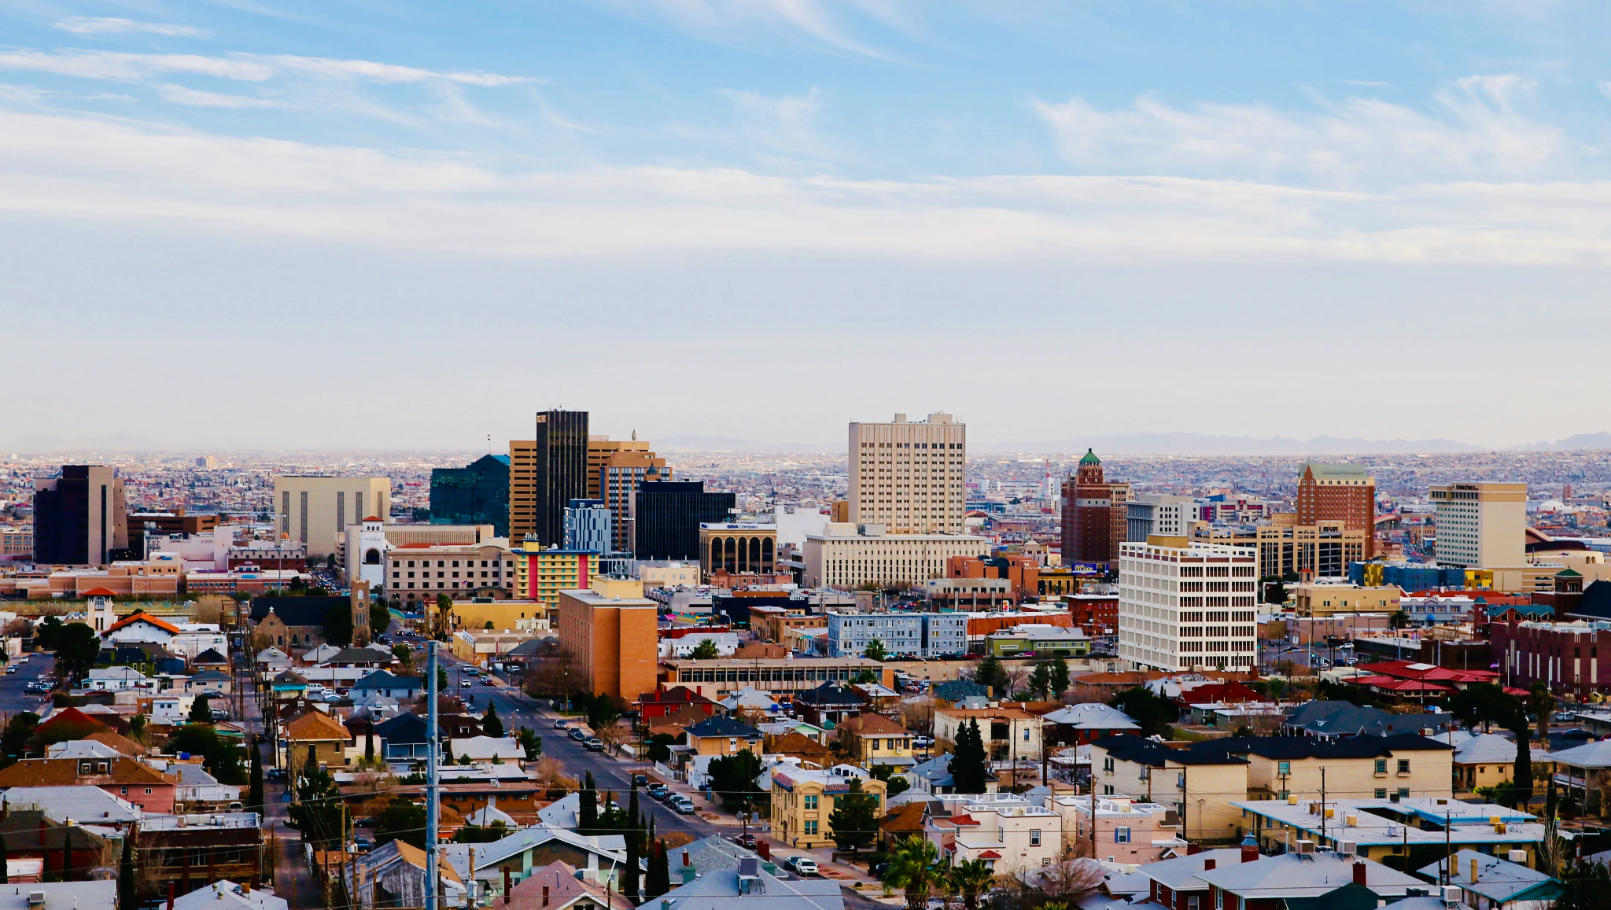
Equity
Safety
Traffic Congestion
Flood Risk
More than just PCI…
Application Development
Image Source: El Paso Times
Notes:
One of the main goals for this project was to bring in other layers to the capital improvement department’s decision making process
They sent out a community survey where they learned that residents most value equity, safety, traffic congestion, and flood risk when thinking about how to improve their city’s road infrastructure
So we wrangled even more data to create our tool the El Paso Road Viewer or EP RV for short.

Slide 26
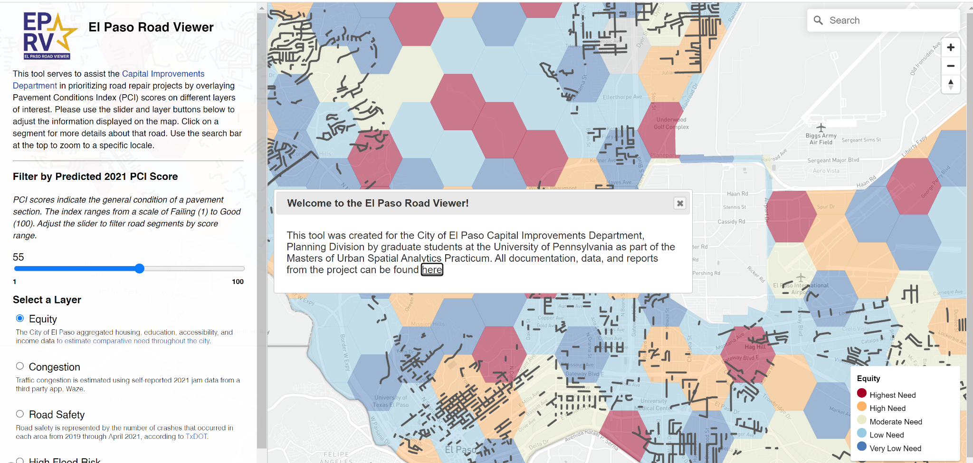
Live link
Notes:
Welcome to EP RV! [switch to new tab for live demo!]
This tool consists of 4 main functions:
First, A PCI slider to adjust the number of roads in the map view based on PCI score. The default is set to 55 which is the score for a “Poor” rating. The number displayed above the slider indicates the upper threshold for the filter, so the map will show all roads with a score of 55 and below
Second, different layers to quickly analyze the roads under different contexts. These are the 4 layers that resulted from the community survey we talked about before.
Third, a search bar so people can type in their street name or a landmark to find the roads near them.
Fourth, a pop up with more information about the specific road segment.
EP RV helps increase transparency, provides quick analysis, and takes the decision making process beyond just PCI.
To prove it, let’s imagine that I’m our client Alex - a planner in the El Paso capital improvements department.
I bring this tool to my big budget meeting this summer where the city is discussing how to improve traffic congestion downtown.
I can toggle on the congestion layer and see which roads fall into areas of high congestion.
Say I want to narrow my search by looking at roads that are only really bad so I can lower the slider to 40 to get that view
now i can quickly propose that improvement projects on these roads that overlap with the dark orange would help improve traffic congestion downtown.
Everyone sees the data, agrees with me, and I can go to my next meeting about stormwater infrastructure,
do the same thing with the flood risk layer, pack up and be home by lunch :)
So that’s how EP RV works!

Slide 27
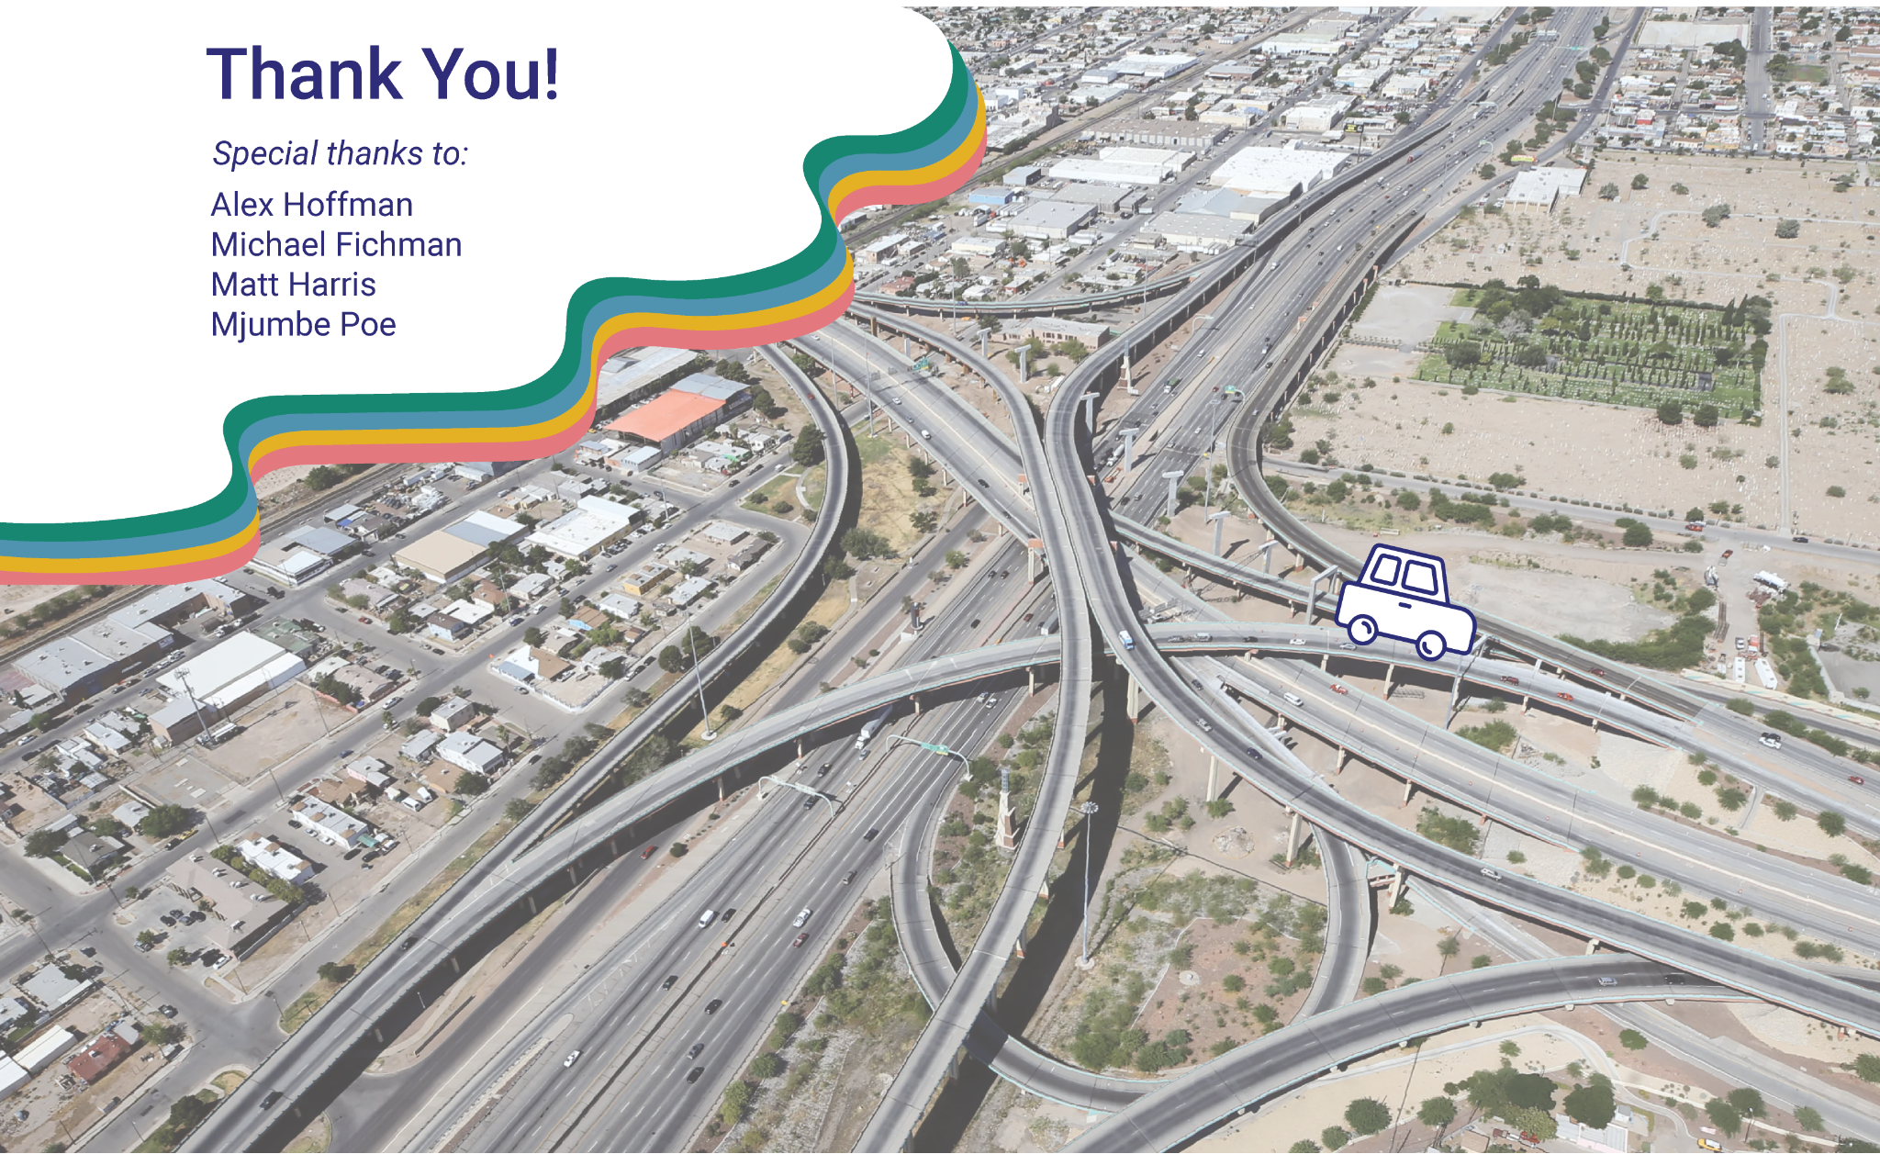
Notes:
We’ve had a really great time this semester building this tool and learning all about roads. We can’t thank Alex enough for all of his support and collaboration and also would like to reiterate thanks to Michael, Matt, and Mjumbe for all of their help and thank you everyone for listening!

